Slide 1
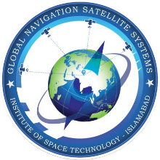
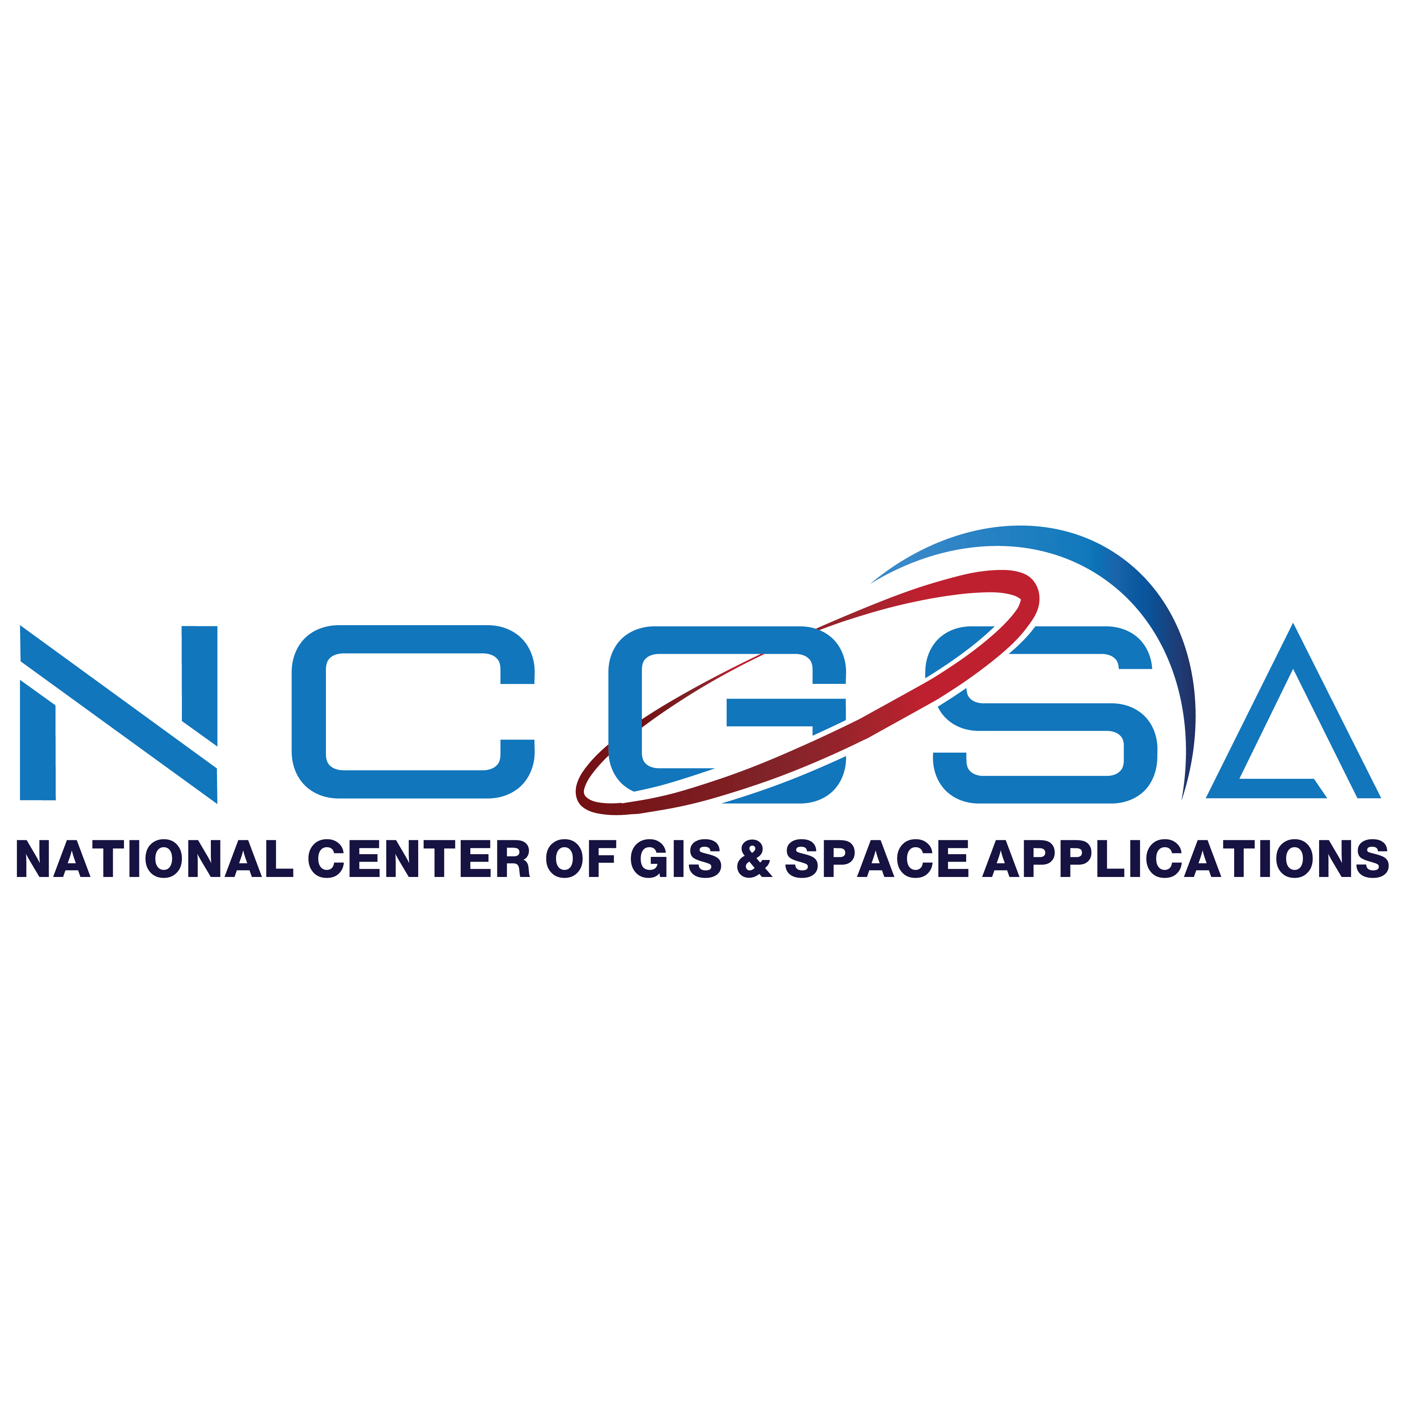


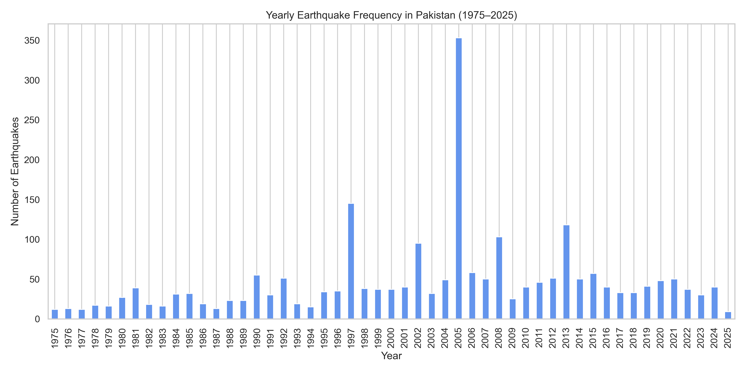
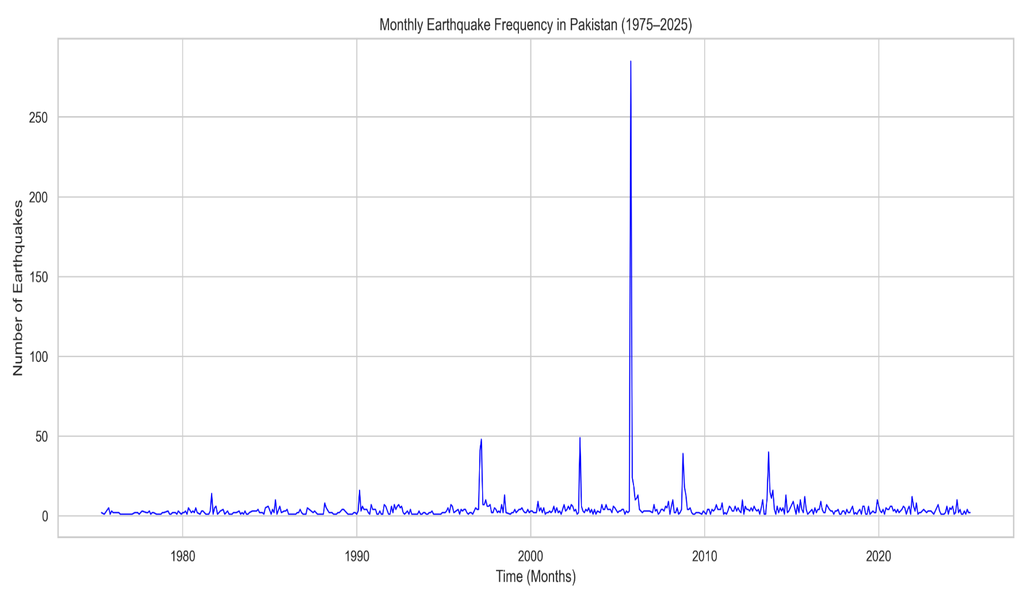
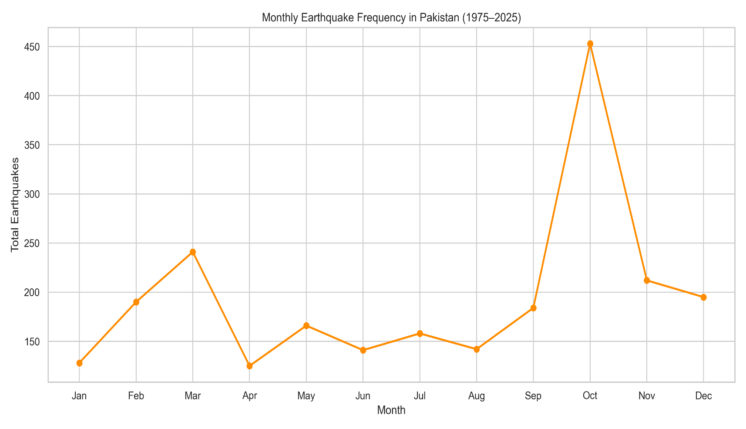
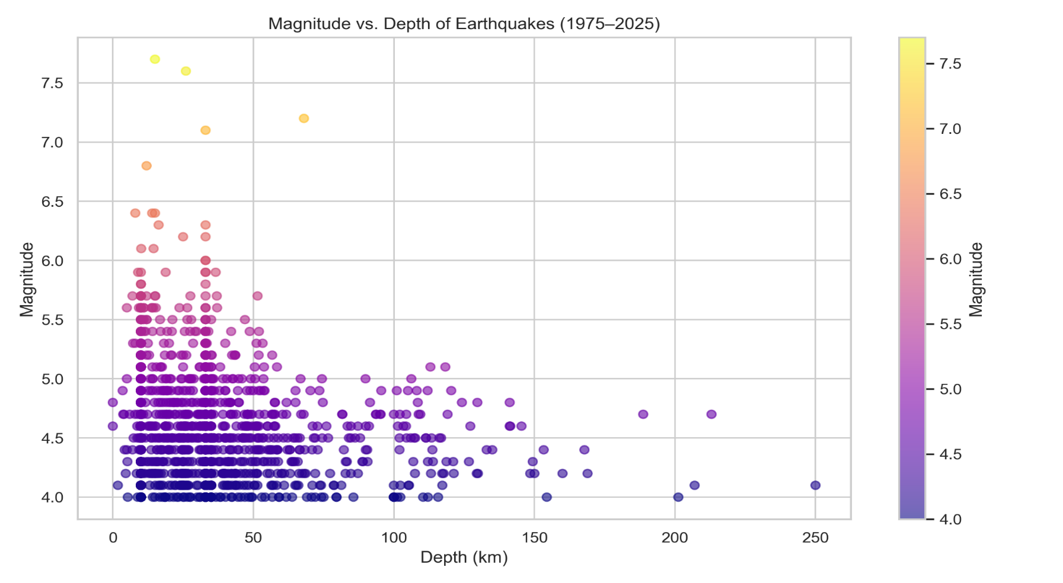
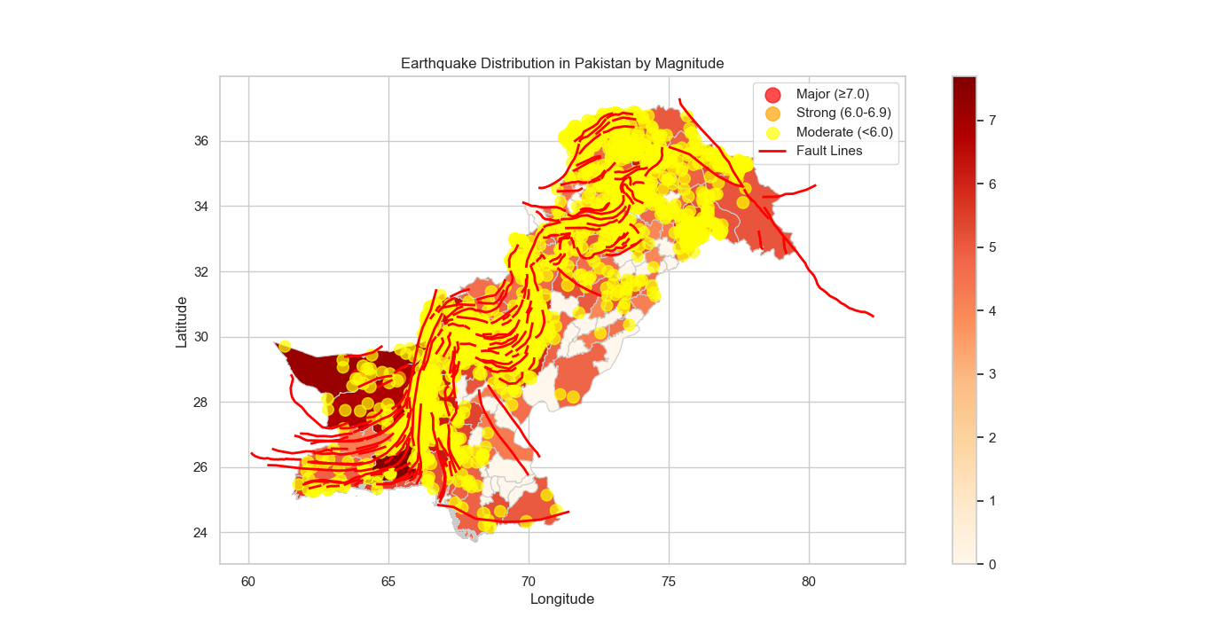
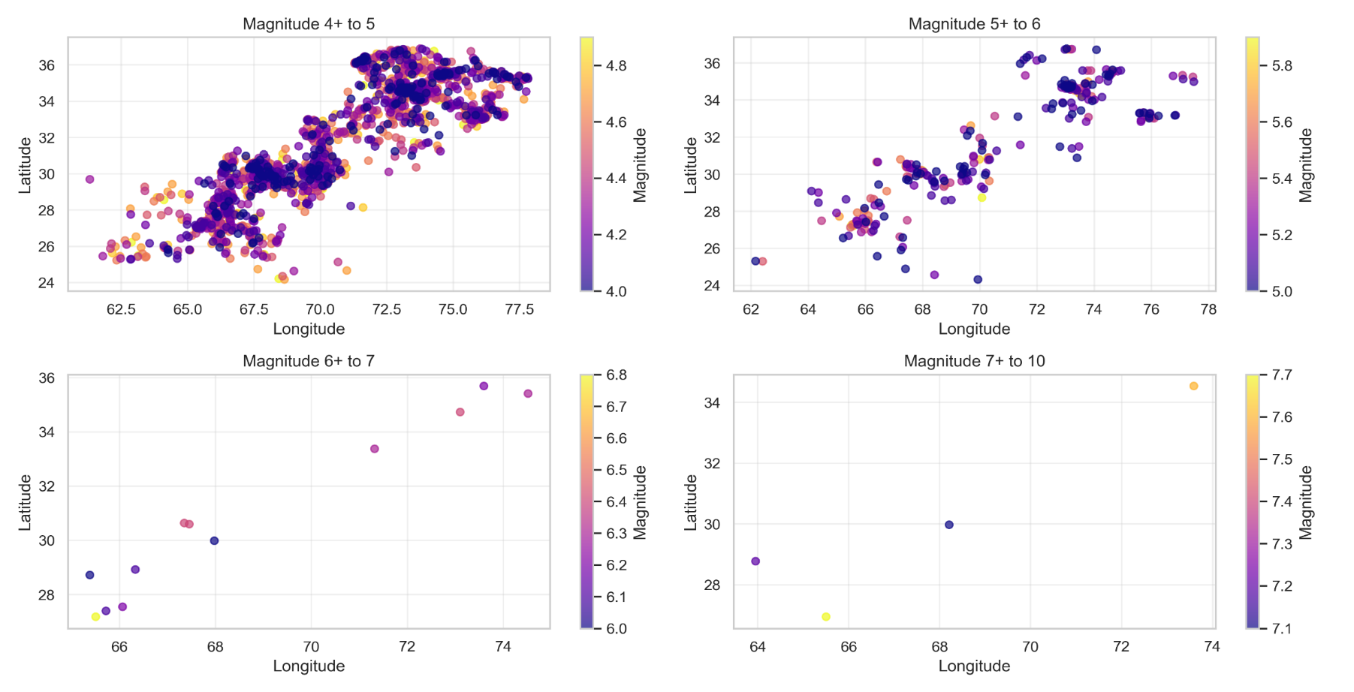
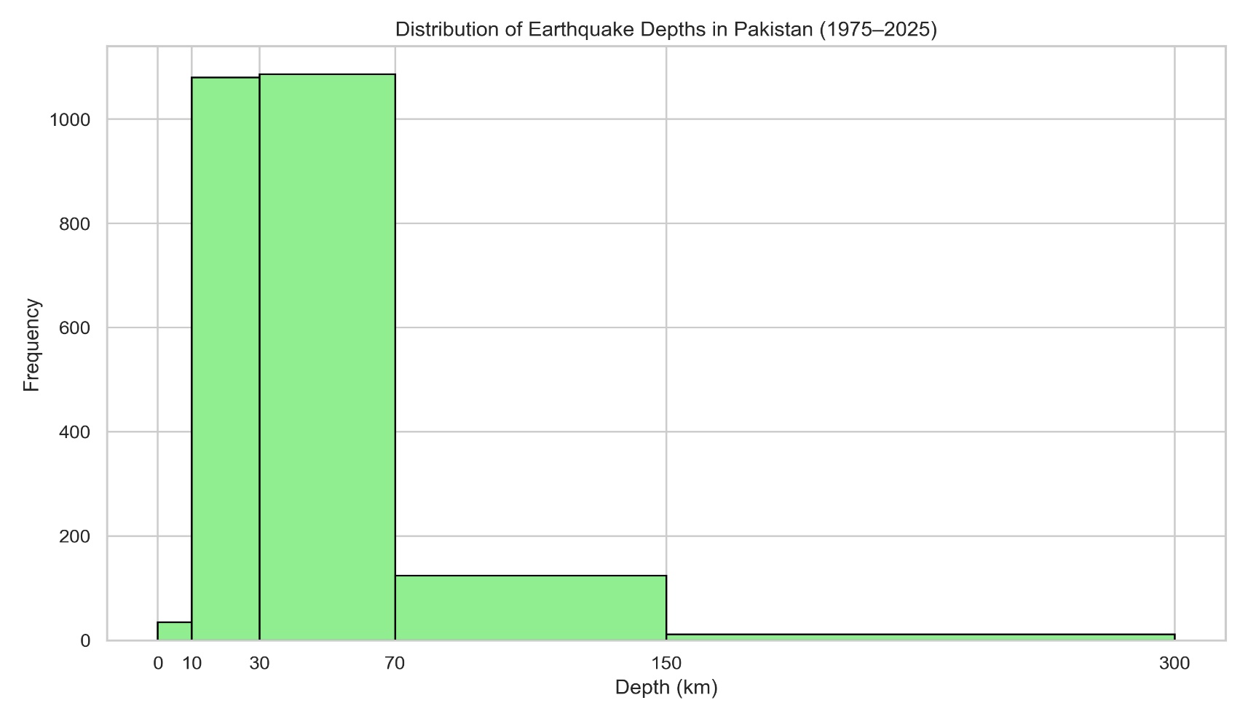
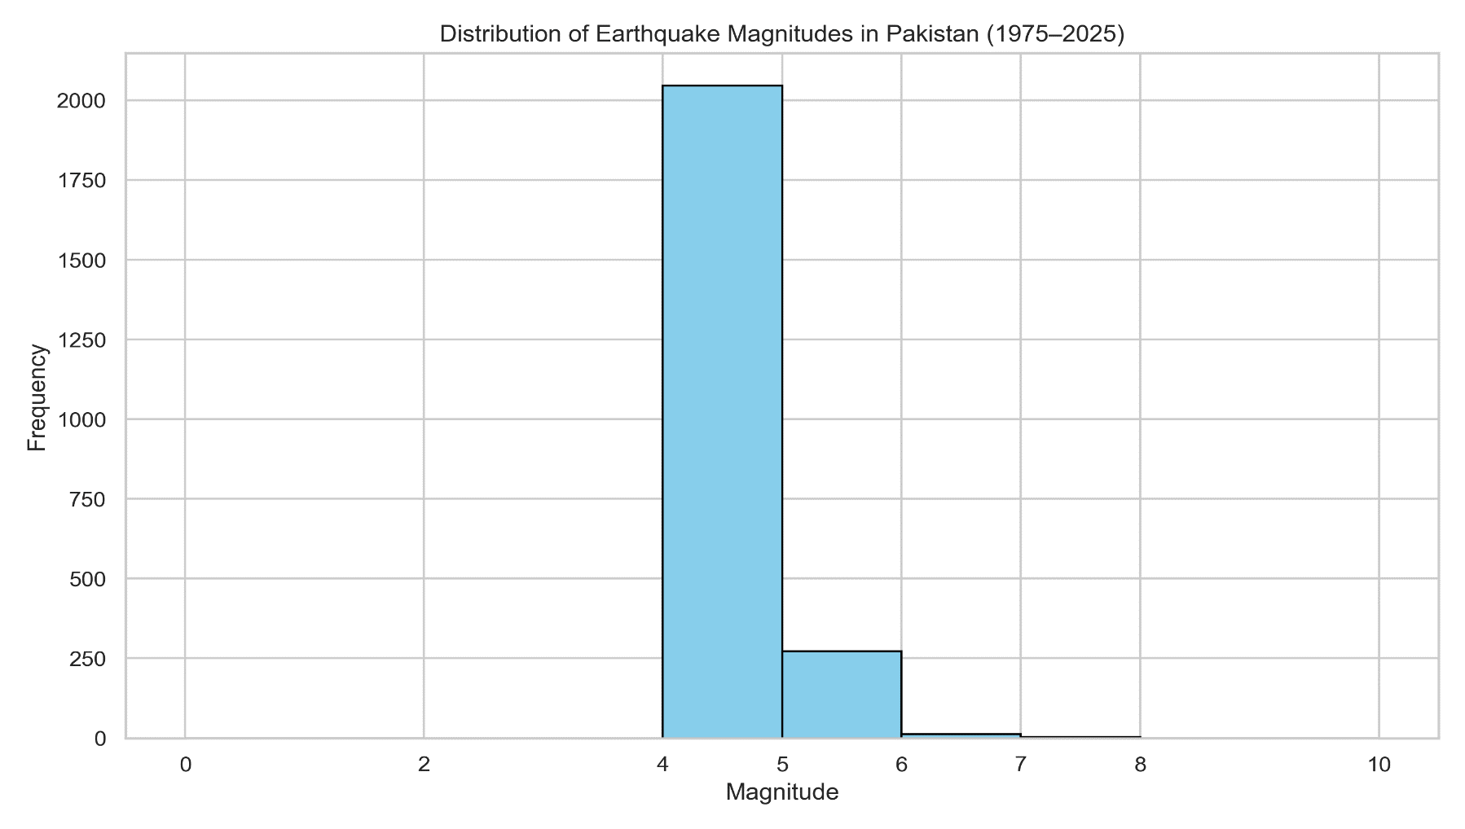
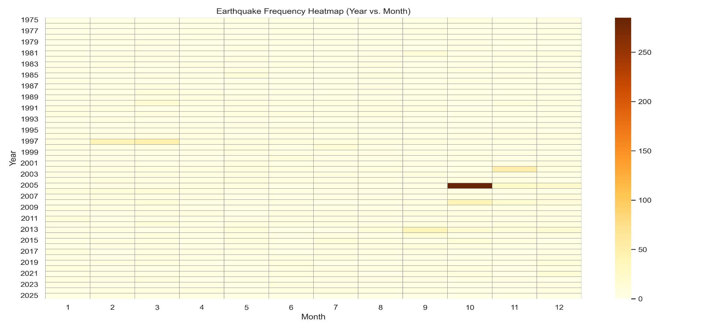



GNSS Research Lab
National Center of GIS & Space Applications
Institute of Space Technology, Pakistan
A GIS Based Analysis of the Past 50 Years’ Earthquakes in Pakistan
Shazia, Abdul Mateen, Dr. Sajid Ghuffar, Usama Ahmed, Dr. Najam Abbas Naqvi
GNSS Research Lab
National Center of GIS and Space Applications
Department of Space Science | Institute of Space Technology, Islamabad
Introduction
Results
The frequency and impact of natural disasters are rising globally, with earthquakes being among the most devastating due to their high mortality rates and potential to trigger secondary hazards like landslides, tsunamis, and liquifaction (Çelik & Yakar, 2023; Shafique et al., 2015). Pakistan, situated in a seismically active region, has experienced numerous destructive earthquakes (Stevenson et al., 2017). Remote sensing and GIS are valuable tools for identifying earthquake-prone areas through the integration of thematic data layers (Smara et al., 2005; Arnous & Green, 2011; Shafique et al., 2011 and 2012; Putra, 2019). GIS-based systems also support hazard forecasting and planning (Sun et al., 2008). Reliable historical earthquake data (magnitude of 2.5 and above since 1973) is accessible through the United States Geological Survey (USGS), and is offering a critical foundation for seismic risk analysis (Memon, 2018).
Problem Statement
To analyze the distribution of earthquake activities in Pakistan from 1975 to 2025.
To assess trends in earthquake frequency, depth, and spatial clustering for the events with magnitude ≥ 4.0.
To identify high-risk seismic zones using GIS and remote sensing techniques.
Methodology
Data Collection: (USGS: 1975-2025)
Data Pre-processing & Analysis: (Python Based)
Visualization: (Interactive Map & Statistical Plots)
Integration with GIS & RS: (Delineate high risk zones and Fault-line analysis).
Discussion
The analysis confirms that Northern and Western Pakistan—particularly Balochistan and Kashmir—experience frequent shallow-earthquakes, increasing surface-level damage risk. These patterns are aligned with previous studies and are linked to the region’s tectonic positioning at the Indian-Eurasian plate boundary.
The integration of Python-based GIS tools proved effective in mapping seismic trends & identifying high-risk zones, supporting better disaster planning, and data-driven insights for hazard mitigation.
Findings support proactive planning and contribute to climate resilience by informing land-use decisions and infrastructure development in seismically vulnerable regions. The approach highlights the role of geospatial technologies in addressing geological risks under a changing climate
Acknowledgment
This Research is supported by National Center of GIS & Space Applications funded by higher commission of Pakistan under ministry of Planning development & special Initiatives
ncgsa.org.pk
ist.edu.pk
ncgsa
GNSSResearchLab
051-9075799
ncgsa.ist

